Slide 1
Smart Emergency Traffic Management
S Sai Narasimha
CS21B1034
CS5005 - IIoT and Cloud Computing Assignment

Slide 2
Table of Contents
Introduction
Aim of the Project
Hardware/ Software Required
Problem Statement
Methodology
Results
Conclusion/ Future Work

Slide 3
Introduction
Urban cities are intricate webs of interdependent subsystems, with the traffic system acting as a pivotal cornerstone to the global economy. However, escalating population rates have led to a surge in vehicular traffic, resulting in daily congestion.
The repercussions are dire, with road congestion significantly impeding emergency response times, potentially costing lives. Studies indicate that up to 65-70% of fatalities could have been prevented with prompt emergency services.
To address this pressing issue, we propose an innovative solution: an IoT-enabled Smart Traffic Management System (STMS) that automatically regulates traffic signals.

Slide 4
Aim of the Project
Our Smart Traffic Management System addresses delays faced by emergency vehicles in congested urban areas. Traditional methods struggle to adapt to increasing vehicle numbers, hindering timely responses.
Our solution integrates RFIDs systems to efficiently manage traffic. Upon detecting an approaching emergency vehicle, the STMS swiftly adjusts traffic signals, creating Green Corridors for unimpeded passage.
Additionally, the system communicates with LCD screens to notify vehicles to yield and shift lanes, minimizing response time delays.

Slide 5
Hardware/Software Required
List of Hardware
1) ESP8266 Development Board 2) RFID Reader (MFRC522) 3) RFID Tags or Cards 4) RGB LED Lights 5) LCD Display (LiquidCrystal I2C) 6) Breadboard and Jumper Wires 7) Arduino Uno (for power supply of LCD 16x2 with I2C)
List of Software
1) Arduino IDE 2) ESP8266 Board Support Package (BSP) for Arduino IDE 3) Blynk IoT Platform 4) RFID Library for Arduino 5) LiquidCrystal I2C Library 6) SPI Library 7) WiFi Library 8) MFRC522 Library

Slide 6
Problem Definition
Problem Solved:
Traditional traffic management methods fail to accommodate increasing vehicle numbers, resulting in congestion that hampers emergency response times.
Inadequate road infrastructure exacerbates congestion, particularly in urban areas, hindering the timely arrival of emergency services.
Studies highlight a significant disparity between economic expansion and the growth of road infrastructure.
Relevance of the Problem:
Delays in emergency response due to traffic congestion can have severe consequences, impacting the ability to save lives and worsening outcomes for those in need of urgent medical assistance.
As urban populations continue to grow and vehicle numbers rise, the problem of traffic congestion becomes increasingly relevant and urgent.
Addressing traffic congestion is crucial for optimizing urban infrastructure and ensuring the efficient functioning of emergency services, ultimately enhancing public safety and well-being.

Slide 7
Methodology
Contributions Made in the Project:
Research and Analysis: Conducted research on traffic congestion issues in smart cities and analyzed existing solutions.
Design and Development: Designed the system architecture for the IoT-enabled traffic management system.
Hardware Integration: Integrated RFID RC522 module with ESP8266 microcontroller for vehicle detection.
Software Development: Wrote code for RFID tag detection, LED control, and LCD display interaction.
Blynk Integration: Integrated the Blynk platform for real-time monitoring and control of the system.
Testing and Debugging: Conducted extensive testing of hardware and software components to ensure reliability and performance.
Documentation: Documented project requirements, design specifications, and implementation details.
Presentation: Prepared presentations and demos for project reviews and presentations.

Slide 8
Methodology
Procedure Followed in Brief:
Requirement Gathering: Identified the need for a traffic management system to address congestion and emergency vehicle priority.
Research and Analysis: Researched existing solutions, technologies, and best practices in traffic management and IoT.
Design Phase: Designed the system architecture, including hardware components and software modules.
Hardware Setup: Procured necessary hardware components and assembled the RFID RC522 module with the ESP8266 microcontroller.
Software Development: Wrote code to interface with the RFID module, control LEDs, interact with the LCD display, and integrate with the Blynk platform.
Integration and Testing: Integrated hardware and software components, conducted testing to ensure functionality and reliability.
Documentation and Presentation: Documented project details, including requirements, design, implementation, and testing. Prepared presentations and demos for project reviews and presentations.

Slide 9
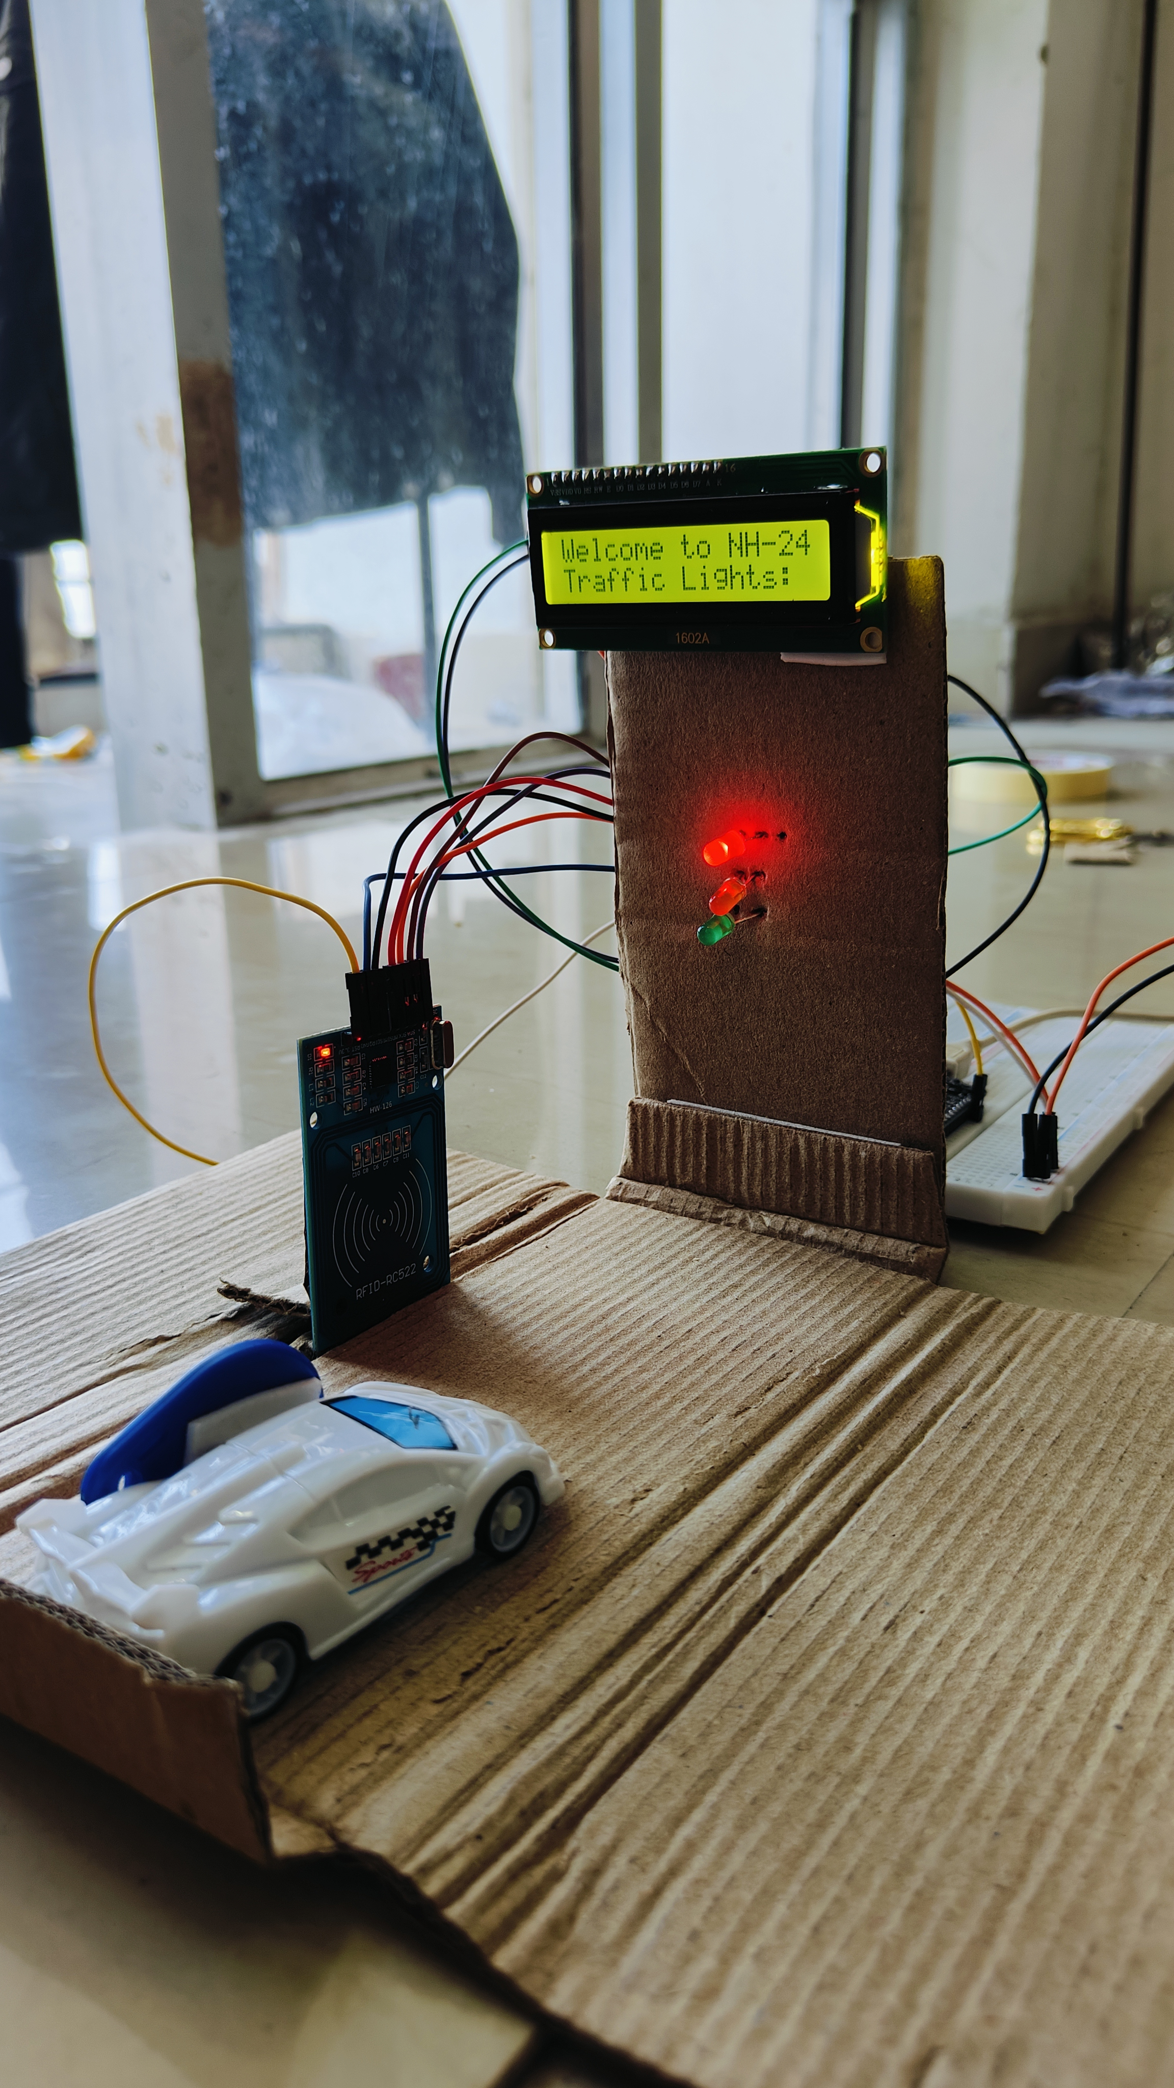
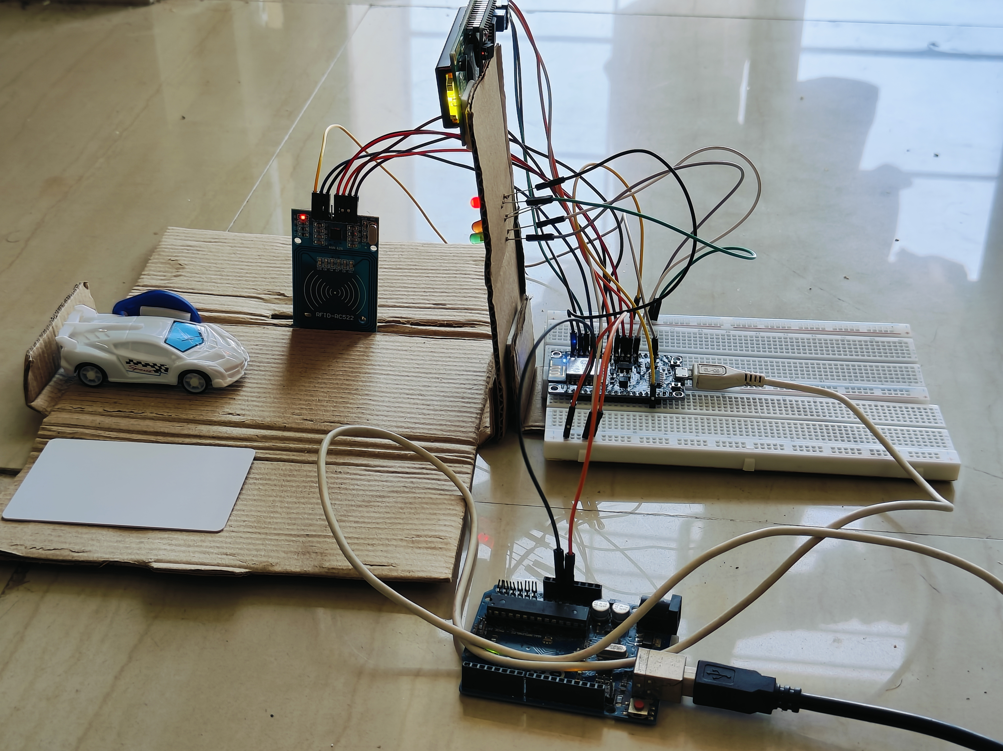

Slide 10
Analysis/ Results
Results Obtained:
Successful integration of RFID RC522 module with ESP8266.
Reliable detection of RFID tags.
LED control indicating ambulance presence and traffic status.
LCD display showing instructions to drivers.
Integration with Blynk for real-time monitoring.
Understanding of the Results:
Improved traffic management with priority for emergency vehicles.
Enhanced safety by reducing response times.
IoT technology enables dynamic traffic control.
User-friendly interface via Blynk platform.
Modular design allows scalability and flexibility.

Slide 11
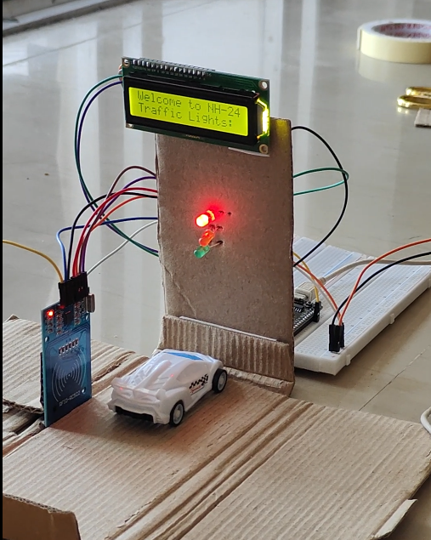
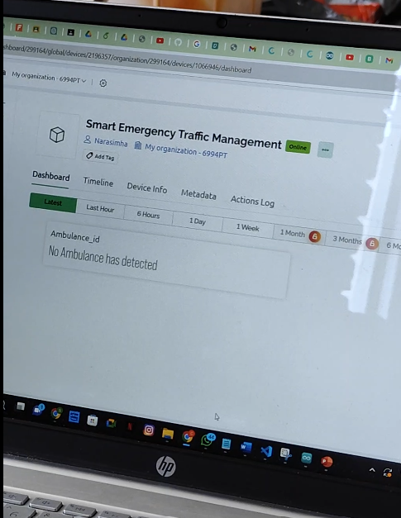
Vehicle without RFID tag
Output

Slide 12
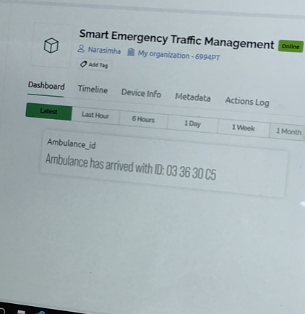
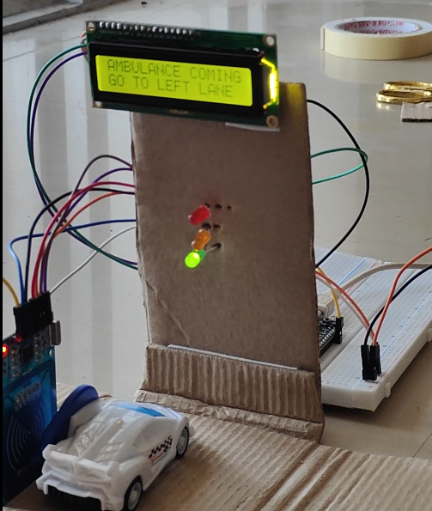
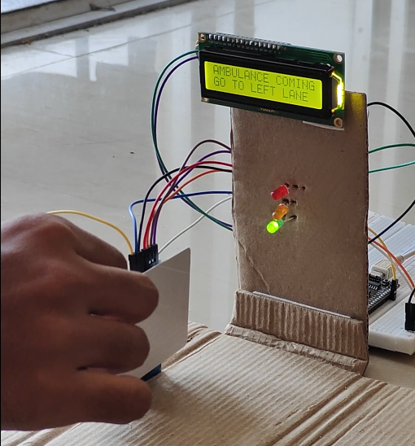

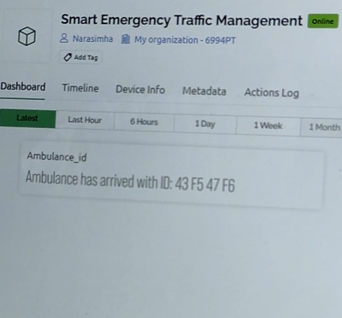

Output
Ambulance with RFID tag
RFID tag

Slide 13
Conclusion
Concluding Remarks:
The project successfully demonstrates the effectiveness of IoT technology in improving traffic management and emergency vehicle access.
Future Plans:
Explore further enhancements, such as vehicle-to-vehicle communication and AI-driven traffic prediction algorithms, to optimize traffic flow.
Collaborate with local authorities to implement the system in real-world smart city environments, contributing to safer and more efficient urban transportation.
Analyze the number of ambulances passing through specific locations to optimize traffic management.
Implement intelligent routing algorithms to provide the best routes for ambulances to reach hospitals, minimizing response times and saving lives.

Slide 14
References
https://ieeexplore.ieee.org/document/9362753/references#references
Google

Slide 15
Thank You Any Questions?

